Slide 1
5DH DC-DC Calibration issue

Slide 2
Vehicle Level
HV Battery
5DH
Dash
CAN BUS:
CAN BUS:
DCDC_ElecSysFailureDisplay
LV Battery
DTC in Fault Memory:
1AA149

Slide 3
System Architecture
Input Current Sensor
LLC Current Sensor
HvController
(Microchip)
LvController
(TC222)
UART
Signal From HV to LV → Input current value „signal name xxx“
„Iin_10mA“ →Signal name
> Calibration Data Stored where?
> Calibration Happening in the LV controller.
Input current sensor sense false current Real current Amps → 0
Sensed current Amps → 2.2A
The calculated current differnece between the input and LLC sensor difference greater than the limit (50A)

Slide 4
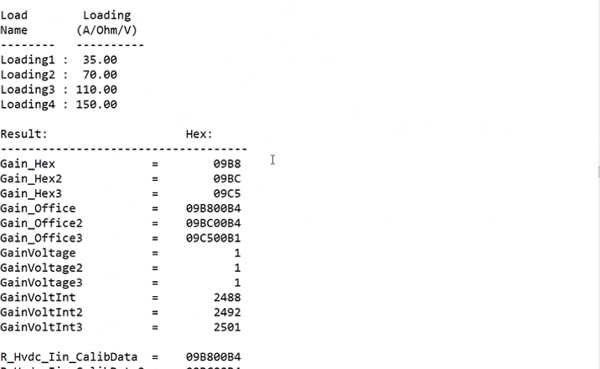
Calibration Procedure
4 Point calibration → 0,35,90,150(new calibration points)
→ 35,70,110,150 (Old values)

Slide 5
DTC 0x1AA149

Slide 6
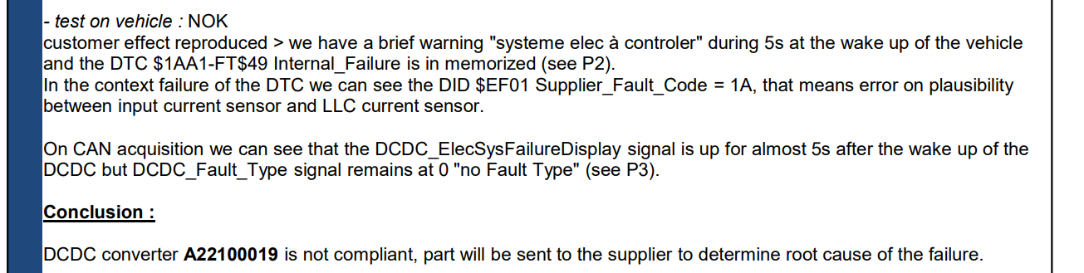
Problem Statement
An issue with the accuracy and/or calibration of the 5DH Step1M input and output current sensor and hence an Error DTC triggered:
Customer Comment:

Slide 7
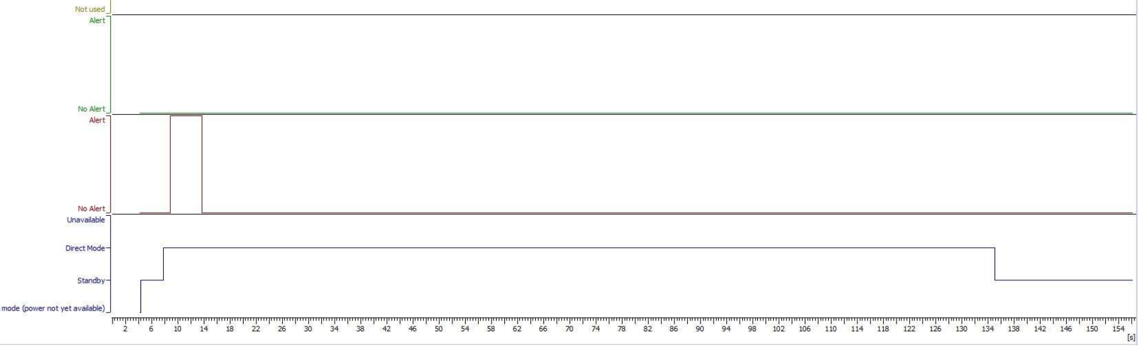
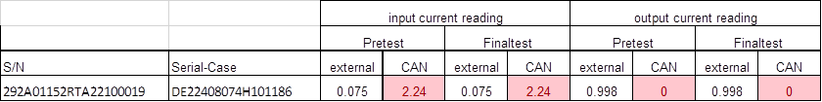
Problem Statement

Slide 8
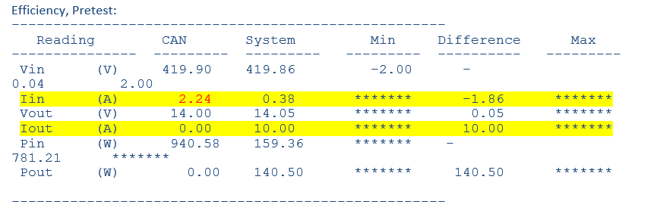
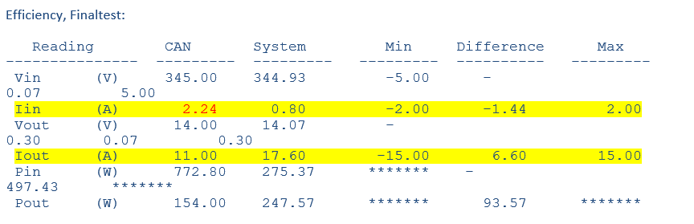
Problem Statement

Slide 9
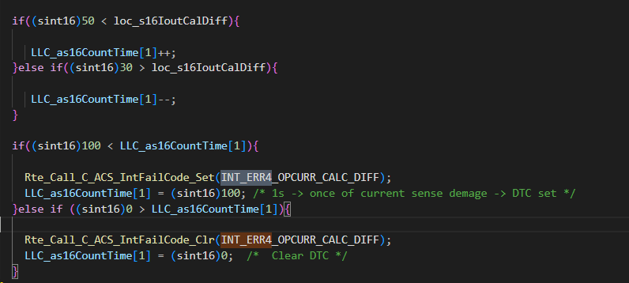
Analysis
As per reactivity table the mature time is 2 Seconds, where as in the implementation it has been set to 1 Second.

Slide 10
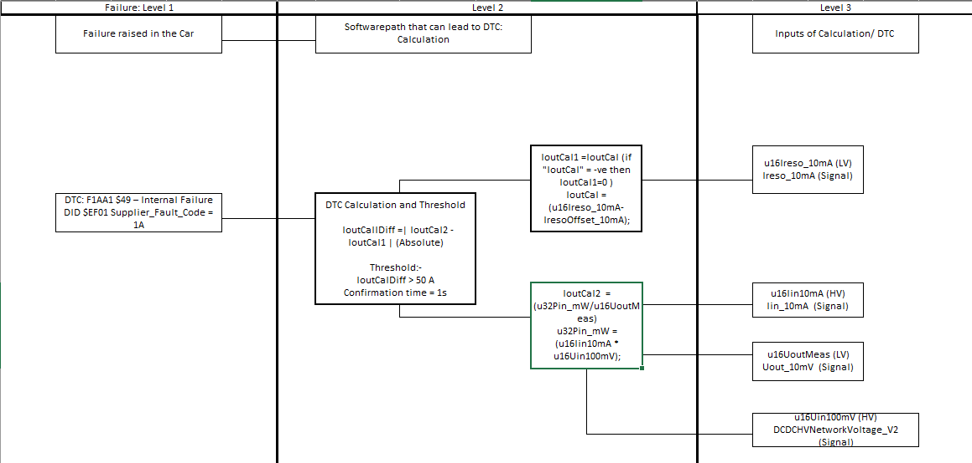
Analysis

Slide 11
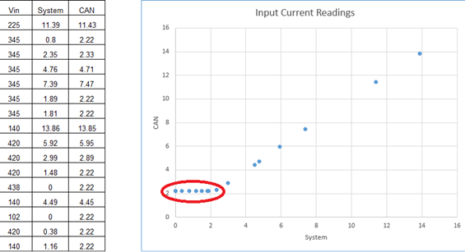
Analysis
External current and CAN current calculation at lower ranges (0~2.2A) not matching and triggering the DTC(probably due to the improper calibration)

Slide 12
Proposed Solution
Increase mature time to a graceful time period (~2 Seconds)to acheive the required current range → feasibility study for 3 Sec
Masking the DTC for the lower input current range(0~2.5A)→ OK
Difference to ~80 A → OK

Slide 13
Smarter. Greener. Together.

